Slide 1
Credit Card Data Analysis
EDA Project -1
- Vikram Singh

Slide 2


What is Credit Card?
Credit Card is the payment card that enables the customers to shop goods and services or withdraw advance cash on credit.
Why we need Credit Card Analysis?
To Determine the borrower’s ability
Quantifying the risk or loss of lender
Sales and Profit Expectation

Slide 3

Why we are here?
We have the data of the “Happy Customer Bank” which is a Mid-Sized Private bank , deal in all kind of banking products.
Bank wants to cross sell its credit cards to its existing customers and for that bank wants to identify the patterns and analyse the dataset.

Slide 4

Data we have…
We divided all the given data into 2 types:
Categorical
Numerical
Customer Id
Gender
Region Code
Occupation
Channel Code
Credit Product
Active in last 3 months
Interest of customer for credit card
Age
Vintage
Average Account Balance

Slide 5
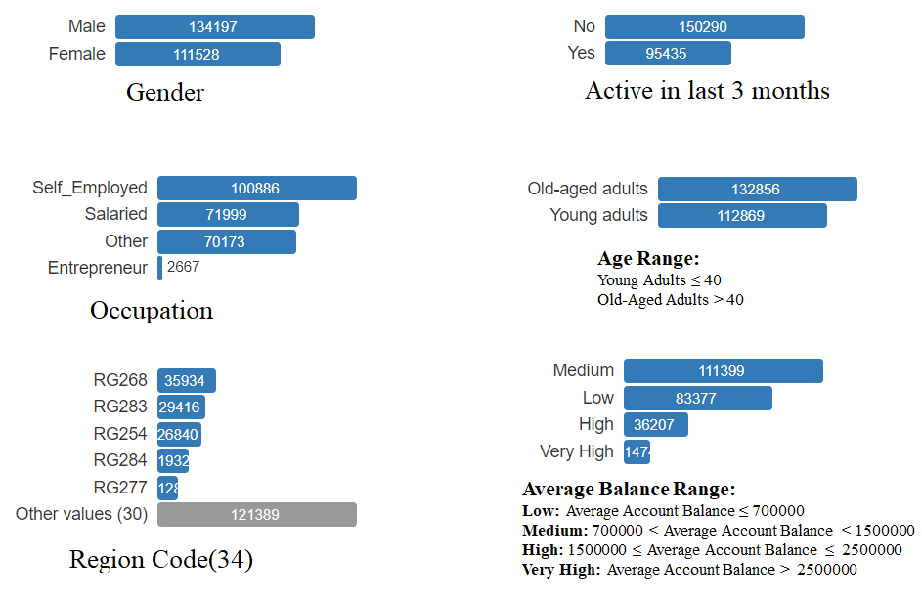
Exploratory Data Analysis

Slide 6
Around 54.61% of customers are Male.
Around 14.62% of customers are from region RG268.
Around 41.06% of customers are self employed and only 1.09% are Entrepreneur.
Around 61% customers are not active since last 3 months.

Slide 7
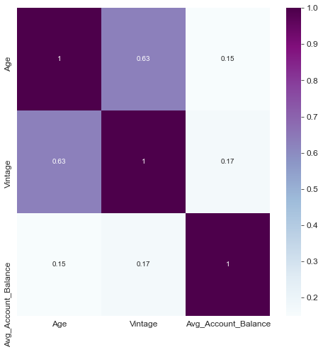
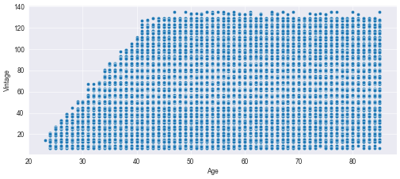
Age – Vintage are highly correlated.
Old – Aged Adults are staying with the banks since the last 100 months.

Slide 8
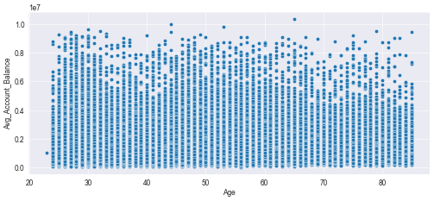
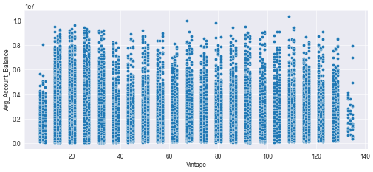
Average Account Balance is same for every age group.
Customer staying with bank maintain Average Account Balance.

Slide 9
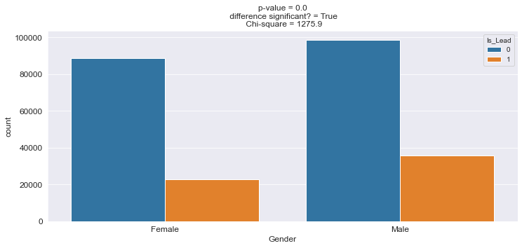
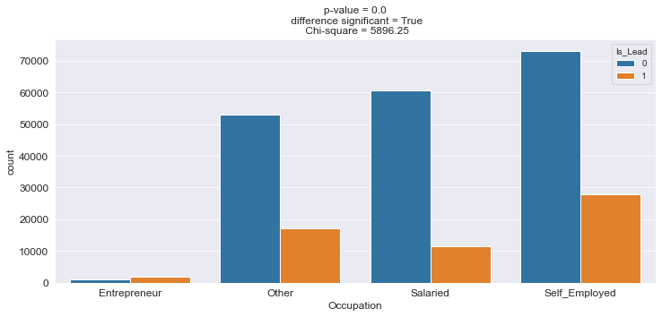
By the p-value of the chi-square test ,
difference between Male and Female
interest for credit card is significant,
Females are less likely to be interested
for the credit cards.
By the p-value of the chi-square test,
Occupation has significant impact on
interest for the credit cards.
Entrepreneur are less likely to be interested for the credit cards.
Notes:
epreneur

Slide 10
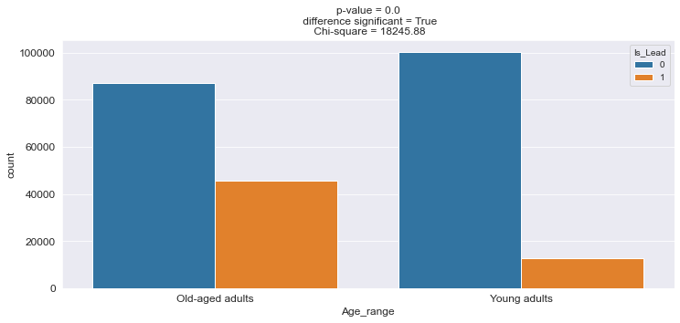
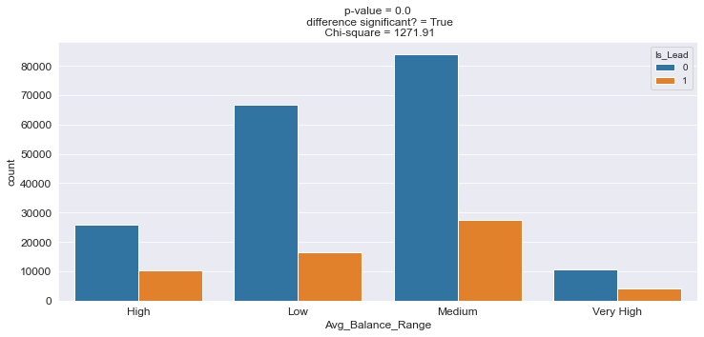
By the p-value of the chi-squared
test, Age range has significant impact on interest for the credit cards.
Young Adults are less likely to be
interested for the credit cards.
By the p-value of the chi
-squared test, Average Balance Range has significant impact on interest for the credit cards.
Medium range are more likely to be interested for the credit cards.

Slide 11
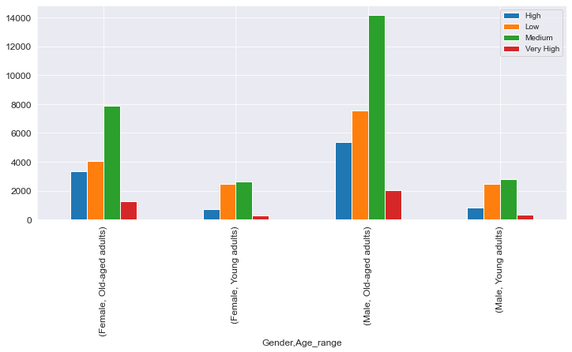
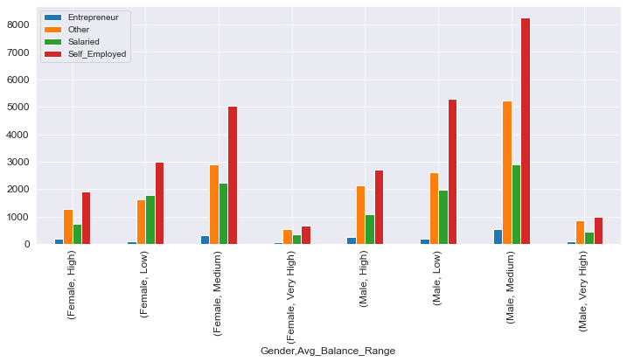
Young Adults are less likely to
take the card in comparison of Old-Aged Adults.
In Old-Aged, gender lying in
medium range of Average Balance are more interested for credit cards.
Both self – employed male and female lying in Medium range of Average Balance range are more interested for credit cards.

Slide 12
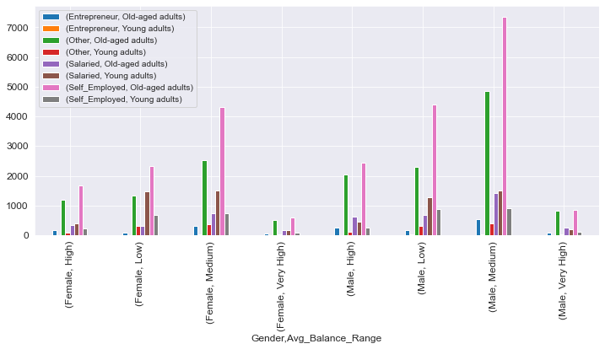
Old-aged, Self – Employed customer lying in Medium Range of Average Balance Range are more interested for the credit cards.

Slide 13

Conclusion:
Around 61% of the customers are not active since last 30 days.
Customers of age greater than 40 years are staying with the
banks since last 100 months.
Young Adults, Females and Entrepreneur are less likely
to be interested for credit cards.
Old-aged, Self – Employed customer lying in Medium
Range of Average Balance Range are more interested for
the credit cards.

Slide 14

Recommendations:
Bank should more focus on the customer having Average Account balance in (7,00,000 , 15,00,000).
Bank can do different kinds of communications with Female and Young Adults for promotions and offers to attract them.

Slide 15
Thank - You

